Slide 1
Lecture 08
Oral reporting and public speaking

Slide 2
Oral reporting and public speaking
MASTERING FORMAL SPEAKING
While the previous lecture addressed the informal, interpersonal types of oral communication you might encounter in business, this lecture addresses the more formal types of oral communication—oral reports and speeches—that you will be likely to prepare in any professional setting.

Slide 3
Reporting orally

Slide 4
Oral reporting
Defining Oral Reports In its broadest sense, an oral report is any presentation of facts and their interpretation using the spoken word.
They vary widely in formality.
At one extreme, they cover the most routine and informal reporting situations.
At the other, they include highly formal presentations.

Slide 5
Oral reporting
Understanding the Differences between Oral and Written Reports -
Visual and Verbal Cues - For written reports, readers rely on visual cues to interpret written reports. To help them, you can use paragraphing to show the structure of the message and to make the thought units stand out.
In addition, you can use punctuation to help show relationships, subordination, and qualification.
When you make an oral presentation, you cannot use many of these techniques.

Slide 6
Oral reporting
However, you can use inflection, pauses, volume emphasis, and changes in the rate of delivery.
In addition, many speakers incorporate visual cues in their presentations by using slides, photos, and other supporting material.
Degree of Reader Control - The readers of a written report, unlike the listeners of an oral report, control the pace of the communication.
They can pause, reread, change their rate of reading, or stop as they choose.

Slide 7
Oral reporting
Since the readers set the pace, writing can be complex and still communicate.
However, since the listeners for an oral report cannot control the pace of the presentation, they must grasp the intended meaning as the speaker presents the words.
For this reason, good presenters keep their reports concise and use handouts or other written material for detailed information that might need careful review.

Slide 8
Oral reporting
Formality in Oral and Written Reports - As with written reports, your use of correct grammar in oral reports is a reflection of your competence.
However, it is often acceptable to use a less formal style in oral reports.
Colloquialisms, contractions, and even slang can be effective with certain audiences.
But do not make the mistake of lapsing into incorrectness in your effort to be engaging.

Slide 9
Oral reporting
Planning the Oral Report -
Determining the Report Objective - This procedure gives you a guide to the information you must gather and to the framework around which you will build your presentation.
In determining your report objective, you must be aware of your general objective. Is it to persuade? To inform? To recommend?
This decision will have a major influence on your development of material for presentation and perhaps even on the presentation itself.

Slide 10
Oral reporting
Organizing the Content - You have the choice of using either the direct or indirect order. Sometimes, direct order may be chosen because of time pressure.
But in general, oral reports are more likely to be delivered indirectly.
In an oral presentation, you will usually state the purpose, give any helpful background information, present the facts and analysis, and then give the conclusions or recommendations.
Even when an oral report is in the direct order, you will probably need to preface your presentation with introductory remarks that provide the context for what you’re about to say.

Slide 11
Oral reporting
In the body of the oral report, as with written reports, you should use a logical structure.
Dividing the subject matter logically, preparing a helpful introduction, and constructing an appropriate conclusion are equally important to both forms.
A major difference in the organization of the written and the oral report is in the ending.
Both forms may end with a conclusion, a recommendation, a summary, or a combination of the three. But the oral report is likely to have a final summary, whether or not it has a conclusion or a recommendation.

Slide 12
Oral reporting
This final brings together all the really important information, analyses, conclusions, and recommendations in the report. It also assists the memory by emphasizing the points that should stand out.
MAKING FORMAL SPEECHES
The first step is to select a topic.
You may be given a topic, or you may select one consider (1) your knowledge, (2) your audience, and (3) the occasion. Then you conduct research to get the information you need.

Slide 13
Oral reporting
Start your speech with greetings. A simple “good morning” or “good evening” may suffice.
If you have not been introduced to your audience, be sure to introduce yourself.
Introduction - The introduction of a speech has much the same goal as the introduction of a written report: to prepare the listeners (or readers) to receive the message.
But it usually has the additional goal of arousing interest. Unless you arouse interest at the beginning, your presentation is likely to fail.

Slide 14
Oral reporting
The situation is somewhat like that of the sales message.
At least some of the people with whom you want to communicate are not likely to be interested in receiving your message.
Speakers can easily lose the audience’s attention. You, the speaker, will have to work to gain and hold the attention of your audience.
The techniques of arousing interest are limited only by the imagination. One possibility is a human-interest story.
For example, a speaker presenting a message about the opportunities available to people with original ideas might open this way:

Slide 15
Oral reporting
“Nearly 150 years ago, an immigrant boy of 17 walked the streets of our town. He had no food, no money, no belongings except the shabby clothes he wore. He had only a strong will to work—and an idea."
Humor, another possibility, is probably the most widely used technique. To illustrate, an investment broker might begin a speech on investment strategy as follows:
“What you want me to give you today is some ‘tried and trusted’ advice on how to make money in the stock market. This reminds me of the proverbial ‘tried and trusted’ bank teller. He was trusted; and when they caught him, he was tried.”

Slide 16
Oral reporting
Humor works best and is safest when it is closely related to the subject of your presentation.
Other effective ways for gaining attention at the opening are by using quotations and questions. By quoting someone the audience would know and view as credible, you build interest in your topic.
You also can ask questions. One kind of question is the rhetorical question—the one everyone answers the same, such as “Who wants to be freed of burdensome financial responsibilities?”
Another kind of question gives you background information on how much to talk about different aspects of your subject.

Slide 17
Oral reporting
With this kind of question, you must follow through by basing your presentation on the response.
If you asked “How many of you have IRAs?” and nearly everyone raised a hand, you wouldn’t want to talk about the importance of IRAs.
You could skip that part of your presentation, spending more time on another aspect, such as managing an IRA effectively.
Yet another possibility is the startling statement. “Last year, right here in our city, in your stores, shoplifters stole over $3.5 million of your merchandise! And most of you did nothing about it.”

Slide 18
Oral reporting
Because of the nature of your subject (as when you must persuade or deliver negative news), you may find it undesirable to reveal a position early.
In such cases, you may prefer to move into your subject indirectly—to build up your case before revealing your position.
Body - Organizing the body of your speech is much like organizing the body of a report.
You take the whole and divide it into comparable parts. Then you take those parts and divide them. You continue to divide as far as it is practical to do so.

Slide 19
Oral reporting
Next you need to emphasize the transitions between the divisions because, unlike the reader who can see them, the listener may miss them if they are not stressed adequately.
Without clear transitions, you may be talking about one point, and your listener may think you are still on the previous point.
Conclusion - Like most reports, the speech usually ends by drawing a conclusion.
Here you bring all that you have presented to a head and achieve whatever goal the speech has.

Slide 20
Oral reporting
You should consider including these three elements in your close:
(1) a restatement of the subject, (2) a summary of the key points developed in the presentation, and (3) a statement of the conclusion (or main message).
Bringing the speech to a climactic close—that is, making the conclusion the high point of the speech—is usually effective.
Present the concluding message in strong language— in words that gain attention and will be remembered.
In addition to concluding with a summary, you can give an appropriate quote, use humor, or call for action.

Slide 21
Presentation method

Slide 22
Oral reporting
Choosing the Presentation Method
Presenting Extemporaneously - Extemporaneous presentation is by far the most popular and effective method.
With this method, you first thoroughly prepare your speech, as outlined above. Then you prepare notes and present the speech from them.
You usually rehearse, making sure you have all the parts clearly in mind, but you make no attempt to memorize.
Extemporaneous presentations generally sound natural to the listeners, yet they are (or should be) the product of careful planning and practice.

Slide 23
Oral reporting
Memorizing - The most difficult method is memorizing. If you are like most people, you find it hard to memorize a long succession of words.
Thus, when you make the speech, if you miss a word or two, you become confused—and so does your speech. You even may become panic-stricken.
Few speakers who use this method likely memorize the entire speech. Instead, they memorize key passages and use notes to help them through the speech.
A delivery of this kind is a cross between an extemporaneous presentation and a memorized presentation.

Slide 24
Oral reporting
Reading - Unfortunately, most of us tend to read aloud in a dull monotone. We also miss punctuation marks, fumble over words, lose our place, and so on.
Of course, many speakers overcome these problems, and with effort you can, too.
In most settings, it is a breach of etiquette to read. Your audience is likely to be insulted, and reading is unlikely to be as well received as an extemporaneous delivery.
However, when you are in a position where you will be quoted widely, such as president of the United States or the CEO of a major company, reading from a carefully prepared speech is recommended.

Slide 25
Oral reporting
PREPARING TO SPEAK
Whether you give your presentation or speech extemporaneously, memorize it, or read it, be sure you are prepared to deliver it.
Of course, the content of a message must be solid, but if your delivery is poor, people may ignore or simply miss your most important points.
Let's check out some strategies for ensuring that your audience receives and understands your message.

Slide 26
Oral reporting
Audience Analysis
As with written messages and reports, a critical component of good presentations is knowing your audience.
You should study your audience both before and during the presentation.
Preliminary Analysis - Analyzing your audience before the presentation requires that you size it up—that you search for audience characteristics that could affect how you should present your speech.
For example, the size of your audience is likely to influence how formal or informal your speech should be.

Slide 27
Oral reporting
As a rule, large audiences require more formality.
Personal characteristics of your audience, such as age, gender, nationality, education, experience, and knowledge of subject matter, also should influence how you make your speech— affecting the words, illustrations, and level of detail you use.
Like writing, speeches should be adapted to the audience. And the more you know about the audience, the better you will adapt your presentation to them.
Analysis during the Presentation - Your audience analysis should continue as you make the speech.

Slide 28
Oral reporting
Feedback is information about how your listeners are receiving your words. Armed with this information, you can adjust your presentation to improve the communication result.
For example, facial expressions will tell you how your listeners are reacting to your message. Smiles, blank stares, and movements will give you an indication of whether they understand, agree with, or accept it.
You can also detect from sounds coming (or not coming) from them whether they are listening.
In general, you can learn much from your audience by being alert, and what you learn can help you make a better speech.

Slide 29
Personal aspects

Slide 30
Oral reporting
Confidence - A primary characteristic of effective oral reporting is confidence - your confidence in yourself and the confidence of your audience in you.
The two are complementary: Your confidence in yourself tends to produce an image that gives your audience confidence in you and your audience’s confidence in you can give you a sense of security that increases your confidence in yourself.
Preparing your presentation diligently and practicing it thoroughly gives you confidence in yourself.
That confidence leads to more effective communication, which increases your listeners’ confidence in you. Hence you should analyze your audience you seek to reach.

Slide 31
Oral reporting
In addition, certain types of dress and hairstyles create strong images in people’s minds, ranging from highly favorable to highly unfavorable.
Yet another confidence-building technique is simply to talk in strong, clear tones. Although most people can do little to change their natural voice, they can use sufficient volume to project a confident tone.
Sincerity - Your listeners are quick to detect insincerity. And if they detect it in you, they are likely to give little weight to what you say.
On the other hand, sincerity is valuable to conviction, especially if the audience has confidence in your ability.

Slide 32
Oral reporting
The way to project an image of sincerity is clear and simple: You must be sincere. Pretense of sincerity is rarely successful.
Thoroughness - Generally, a thorough presentation is better received than a scanty or hurried presentation.
Thorough coverage gives the impression that time and care have been taken, and this tends to make the presentation believable.
But thoroughness can be overdone. Too much detail can drown your listeners in a sea of information.
The secret is to leave out unimportant information. This, of course, requires good judgment.

Slide 33
Oral reporting
Friendliness - A speaker who projects an image of friendliness has a significant advantage in communicating. People simply like friendly people, and they are generally receptive to what such people say.
Like sincerity, friendliness is hard to feign and must be honest to be effective.
Most people are genuinely friendly, but some have trouble projecting a friendly image. By watching yourself as you practice speaking, you can find ways to improve your projection of friendliness.

Slide 34
Appearance and physical actions

Slide 35
Appearance and physical actions
As your listeners hear your words, they are looking at you. As I said, you are a part of the message, so what they see can affect the success of your speech.
Your audience forms impressions from these six factors:
The Communication Environment - Much of what your audience sees is the physical things that surround you as you speak: the stage, lighting, background, and so on.
These things tend to create a general impression. Although not visual, outside noises have a related influence. For the best communication results, the factors in your communication environment should contribute to your message, not detract from it.

Slide 36
Appearance and physical actions
Your own experience as a listener will tell you what factors are important.
Personal Appearance - As I have said, your personal appearance is a part of the message your audience receives.
You should dress in a manner appropriate for the audience and the occasion. You should also be sure that nothing about your appearance (e.g., hairstyle or jewelry) is distracting
Posture - Posture is likely to be the most obvious of the things that your audience sees in you. The trouble is that you are not likely to see it in yourself.
.

Slide 37
Appearance and physical actions
One solution is to have others tell you whether your posture needs improvement.
Another is to practice speaking before a mirror or watch yourself on video.
keep in mind what must go on within your body to form a good posture. You should keep your body erect without appearing stiff and comfortable without appearing limp.
You should appear naturally poised and alert.
Walking - Your audience also forms an impression from the way you walk.

Slide 38
Appearance and physical actions
A strong, sure walk to the speaker’s position conveys an impression of confidence. Hesitant, awkward steps convey the opposite impression.
Facial Expression - Probably the most apparent and communicative physical movements are facial expressions.
Eye contact is also very important. The eyes, which have long been considered “mirrors of the soul,” provide most listeners with information about the speaker’s sincerity, goodwill, and flexibility.
Some listeners tend to shun speakers who do not look at them. On the other hand, discriminate eye contact tends to show that you have a genuine interest in your audience.

Slide 39
Appearance and physical actions
Gestures - gestures are strong, natural aids to speaking.
It appears natural, for example, to emphasize a plea with palms up and to show disagreement with palms down.
Raising first one hand and then the other reinforces a division of points.
Slicing the air with the hand shows several divisions.
Although such gestures are generally clear, we do not all use them in exactly the same way.
Care must be taken so that the audience does not misunderstand the meaning of a particular gesture.

Slide 40
Voice

Slide 41
Voice
Good voice is an obvious requirement of good speaking. Like physical movements, the voice should not hinder the listener’s concentration on the message.
More specifically, it should not detract attention from the message. Voices that cause such difficulties generally fall into these areas of fault:
Lack of Pitch Variation - Speakers who talk in monotone are not likely to hold the interest of their listeners for long.
Since most voices are capable of wide variations in pitch, the problem usually can be corrected.

Slide 42
Voice
Lack of Variation in Speaking Speed - As a general rule, you should present the easy parts of your message at a fairly fast rate and the hard parts and the parts you want to emphasize at a slower rate.
The reason for varying the speed of presentation should be apparent: it is more interesting.
A slow presentation of easy information is irritating; hard information presented fast may be difficult to understand.
A problem related to the pace of speaking is the incorrect use of pauses. Properly used, pauses emphasize upcoming subject matter and are effective means of gaining attention.

Slide 43
Voice
But frequent pauses for no reason are irritating and break the listeners’ concentration.
Pauses become even more irritating when the speaker uses fillers such as uh, like, you know, and OK.
Lack of Vocal Emphasis - A secret of good speaking is to give words their proper emphasis by varying the manner of speaking.
You can do this by (1) varying the pitch of your voice, (2) varying the pace of your presentation, and (3) varying the volume of your voice.

Slide 44
Voice
Some speakers incorrectly believe that the only way to show emphasis is to get louder and louder. But you can also show emphasis by going from loud to soft.
The contrast with what has gone on earlier provides the emphasis. Again, variety is the key to making the voice more effective.
Unpleasant Voice Quality - It is a hard fact of communication that some voices are more pleasant than others. Fortunately, most voices are reasonably pleasant.
And concentrating on variations in pitch, speed of delivery, and volume can make even the most unpleasant voice acceptable

Slide 45
Voice
Improvement through Self-Analysis and Imitation - Listening to audio and video recordings of yourself, you will know how to improve your vocal presentation.
One of the best ways to improve your presentation skills is through watching others.
Watch your instructors, your peers, television personnel, professional speakers, and anyone else who gives you an opportunity.
Analyze these speakers to determine what works for them and what does not. Imitate those good techniques that you think would help you and avoid the bad ones.

Slide 46
Visuals

Slide 47
Visuals
The spoken word is severely limited in communicating. Sound is here briefly and then gone.
A listener who misses the vocal message may not have a chance to hear it again.
Because of this limitation, speeches often need strong visual support: slides with talking points, charts, tables, film, and the like.
Visuals may be as vital to the success of a speech as the words themselves.

Slide 48
Visuals
Proper Use of Visuals - Effective visuals are drawn from the message. They fit the one speech and the one audience.
In selecting visuals, you should search through your presentation for topics that appear vague or confusing.
Whenever a visual of some kind will help eliminate vagueness or confusion, you should use it.
Types to consider - should the visual be an outline, a chart, a diagram, a picture, or what?
You should select your visuals primarily on the basis of their ability to communicate content rather than for appearance and dramatic effect.

Slide 49
Visuals
Use of powerpoint - PowerPoint should supplement the content of a presentation. It is not a substitute for content.
Some say that its purpose is to remind points to the presenter, which the presenter will present in his own way.
Remember that a good slide show helps the listener follow your presentation.
To do so, the listener needs clear, readable text.
A readable slide will also have minimal text, and the text in slide and a graphic must be readable from the back of the room.)

Slide 50
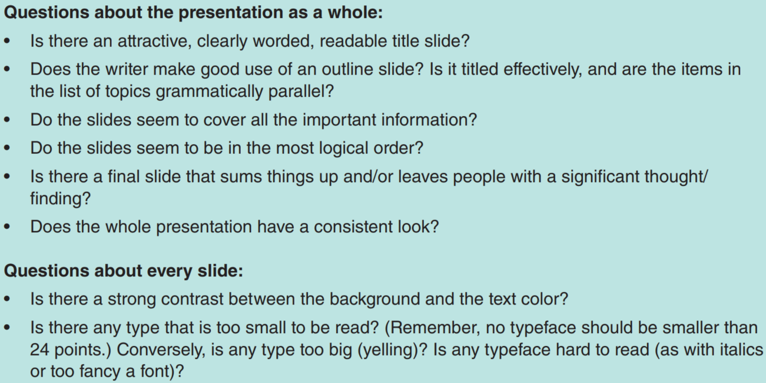
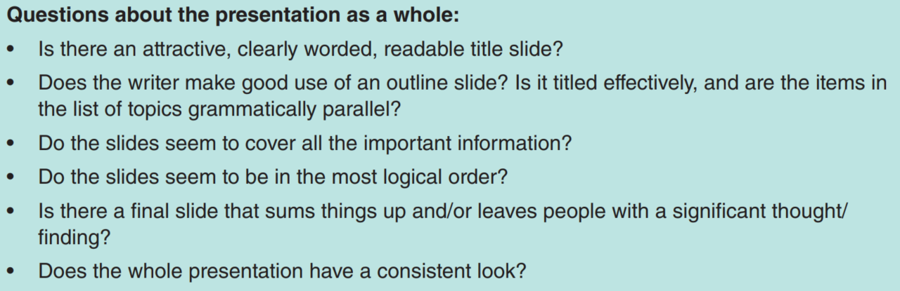
Visuals

Slide 51
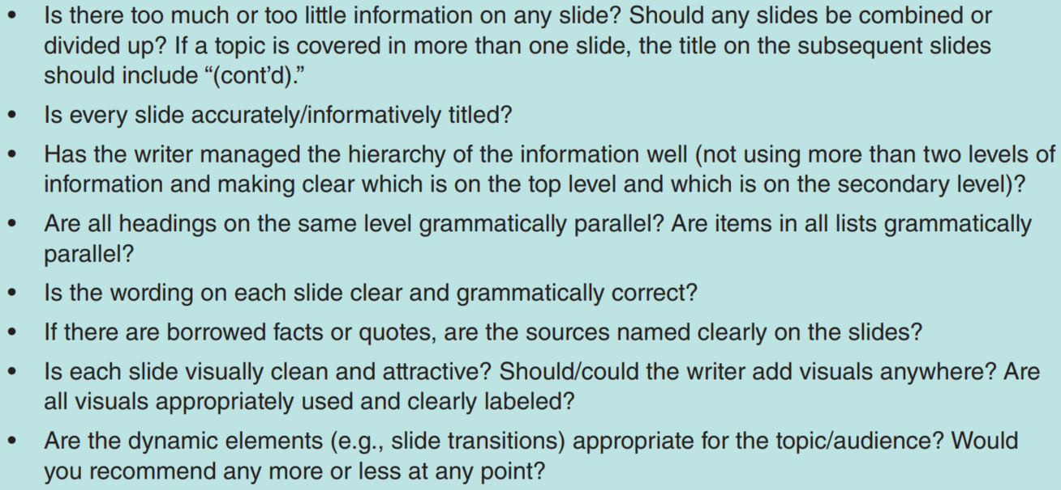
Visuals

Slide 52
Group and virtual meetings

Slide 53
Group and virtual meetings
Group presentations require individual speaking skills plus planning for collaboration.
First, you will need to take special care to plan the presentation—to determine the sequence of the presentation as well as the content of each team member’s part.
You also will need to select supporting examples carefully to build continuity from one part of the presentation to the next.
You should coordinate the type of delivery, use of notes, graphics, and attire to present a good image of competence and professionalism.

Slide 54
Group and virtual meetings
Group presentations require individual speaking skills plus You should also plan transitions so that the team will appear coordinated.
Another presentation aspect—physical staging—is important as well.
Team members should know where to sit or stand, how visuals will be handled, how to change or adjust microphones, and how to enter and leave the speaking area.
If there is to be a question-and-answer session, the team should plan how to conduct it.

Slide 55
Group and virtual meetings
For example, will one member take the questions and direct them to a specific team member? Or will the audience be permitted to ask questions to specific members?
Some type of final note of appreciation or thanks needs to be planned with all the team nodding in agreement or acknowledging the final comment in some way.
In all of their extra planning activities, teams should not overlook the need to plan for rehearsal time.

Slide 56
Group and virtual meetings
PRESENTING VIRTUALLY
Both organizational and technological factors are driving the growth of virtual presentations, specially during the recent pandemic.
The delivery virtual presentation will be much like that for other presentations, except you will be doing it from your desktop using a headphone.
Turn on your video if possible, because there is so much you can add to a presentation with your physical appearance (as discussed earlier).

Slide 57
Group and virtual meetings
You may want to use the highlighter or an animation effects tool in PowerPoint to help you emphasize key points that you would otherwise physically point to in a face-to-face presentation.
You will want to plan breaks where you will poll or quiz the audience or handle questions that have come in through the chat tool.
If you use the presenter’s view in PowerPoint, you can set the timer to help you do this at regular intervals as well as gauge the timing through the questions and speed feedback.

Slide 58
Discussion & debate

Slide 59
Discussion & debate
Explain the principal differences between written and oral reports.
Compare the typical organization plans of oral and written reports. Note the major differences between the two kinds of plans.
Assume that you must prepare a speech on the importance of making good grades for an audience of college students. Develop some attention-gaining ideas for the introduction of this speech. Do the same for a climactic close for the speech.
When is an extemporaneous presentation desirable? When should a speech be read? Discuss.

Slide 60
Discussion & debate
Explain how a speaker’s personal characteristics infl uence the meanings of his or her spoken words.
An employee presented an oral report to an audience of 27 middle- and upper-level administrators. Then she presented the same information to three top executives. Note some of the probable differences between the two presentations.
Explain how feedback can be used in making a speech.
“One’s manner of dress, choice of hairstyle, physical characteristics, and the like are personal. They should have no influence on any form of oral communication.” Discuss

Slide 61
Discussion & debate
By description (or perhaps by example), identify good and bad postures and walking practices for speaking.
Think of ways how facial expressions can miscommunicate.
Give some illustrations of gestures that can be used to communicate more than one meaning. Demonstrate them.
“We are born with voices—some good, some bad, and some in between. We have no choice but to accept what we have been given.” Comment.
What should be the determining factors in the use of visuals (graphics)?

Slide 62
Discussion & debate
Discuss (or demonstrate) some good and bad techniques of using visuals.
In presenting an oral report to a group composed of fellow workers as well as some bosses, a worker is harassed by the questions of a fellow worker who is trying to embarrass him.
What advice would you give the worker? Would your advice be different if the critic were one of the bosses? What if the speaker were a boss and the critic a worker? Discuss.
Give examples of ways a team could provide continuity between members through the use of supporting examples. Be specific.

Slide 63
Discussion & debate
Explain the principal differences between face-to-face and virtual presentations.

Slide 64
Thank you!

